Slide 1


Inventory Data Analysis
Sarthak Arora
May 2024

Slide 2
Transforming Data into Insights using Python’s Exploratory Data Analysis
Data Loading
& Cleaning
Post Joining
Analysis
Data Insights Generation
Key Decisions
Around 221K records from Kroger_inventory1 and 315K records from Kroger_inventory2 are first cleaned and then joined to focused_commodities for specific analysis
Around 193K records from Kroger_inventory1 and 277K records from Kroger_inventory2 became eligible for the analysis due to the required focused commodities.
Major Insights related to Excess items (Overstock), items being out of Stock (Understock), or Storage usability for commodities and their UPC Description will be shared with the respective statistics.
Using the gathered insights, decisions will be taken to ensure the inventory usage optimization and improvement in the sales and demand for particular commodities and their UPC Description

Slide 3
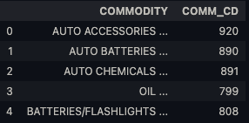
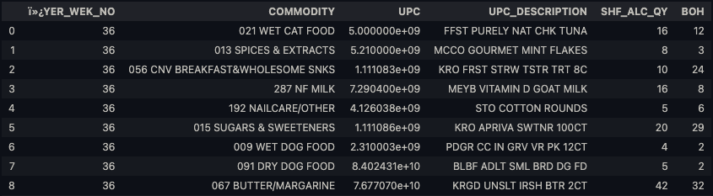
221,021
Data Loading & Cleaning Summary
391
Sample Data Record
Unique Commodities in Focused Commodity file
# of Records in Kroger_Inventory1
715
470,752
Focused Commodity Table
Unique UPC Description/ Items are out of Stock
# of Records eligible for the analysis
315,151
6
# of Records in Kroger_Inventory2
Columns in Kroger’s Inventory files
Sample Kroger’s inventory Data Table

Slide 4
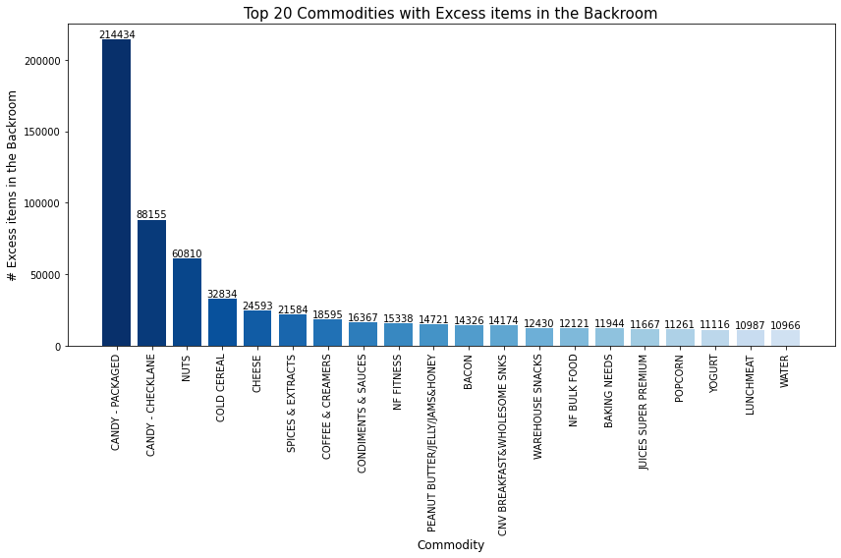
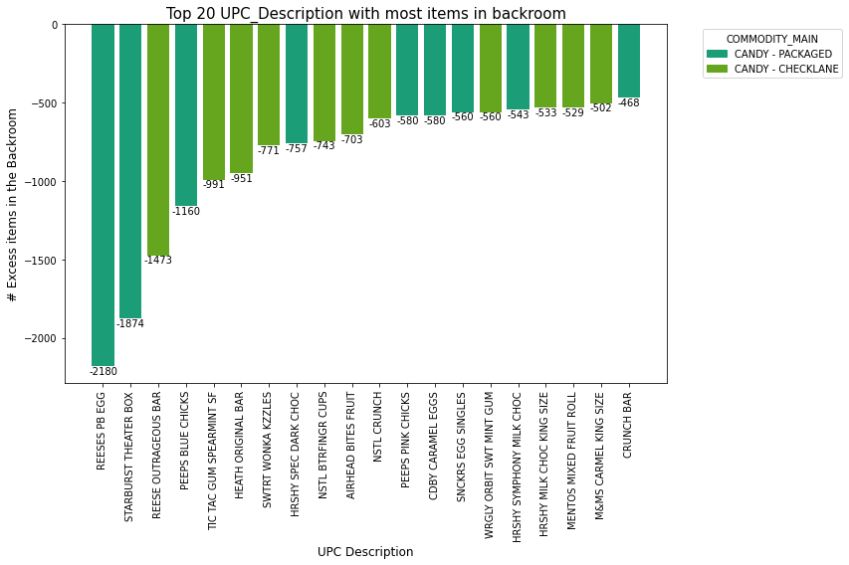
Overstocked Items
Key Takeaway: More than half (64.27%) of excess items in the backroom belongs to Packaged (214K) and Check lane Candies (88K). Most of the candies in the backroom belongs to Reeses

Slide 5
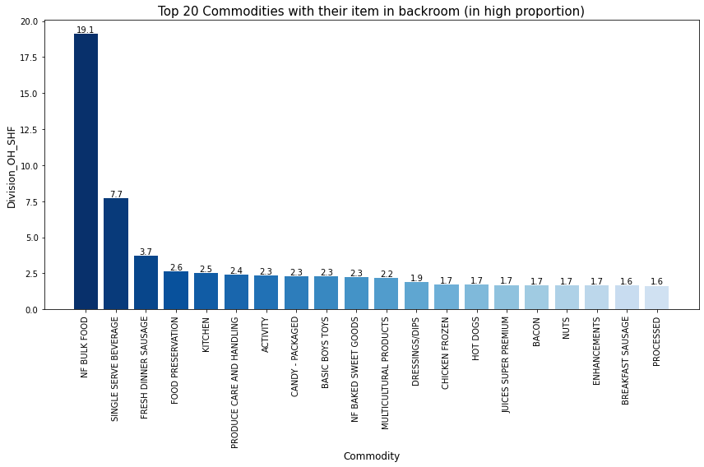
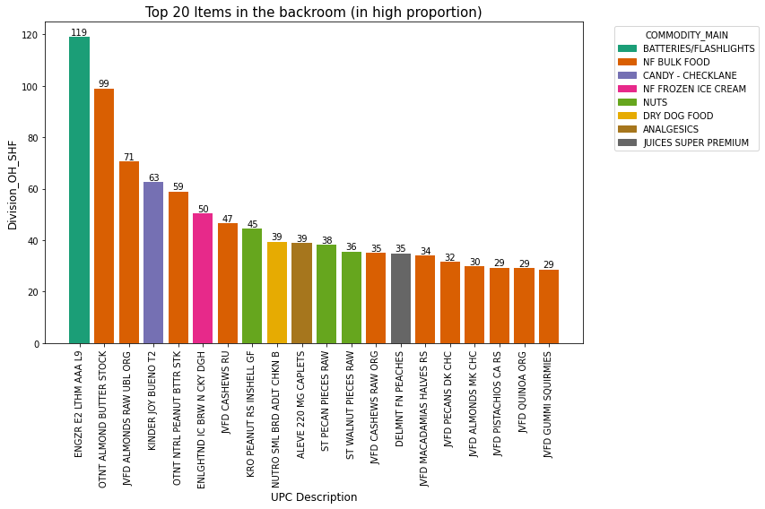
Overstocked Items
Key Takeaway: Although we might see that NF BULK FOOD commodity is stored in excess (around 19 times more than the shelf size) ENGZR E2 LTHM AAA L9 product from the Batteries/Flashlights is stored in excess, around 119 times more than the shelf size.

Slide 6
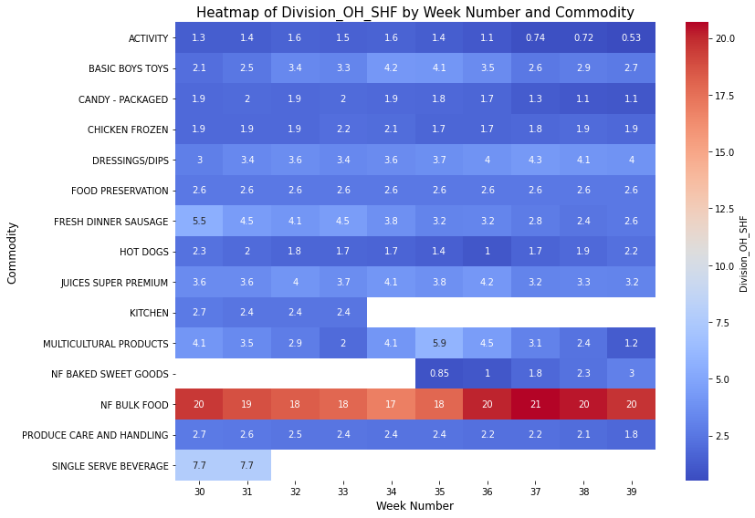
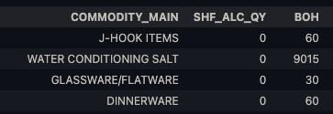
Overstocked Items Ratio
Key Takeaway: Commodities such as J-Hook Items, Water Conditioning Salt, Glassware/Flatware, and Dinnerware struggle with shelf space allocation or utilization, indicating issues in inventory management.
Key commodities with green markers demonstrate well-optimized inventory (Activity, Fresh Dinner Sausage etc) , while those with red markers (NF Bulk Food etc) show inefficiencies, with starred items excelling in both aspects.

Slide 7
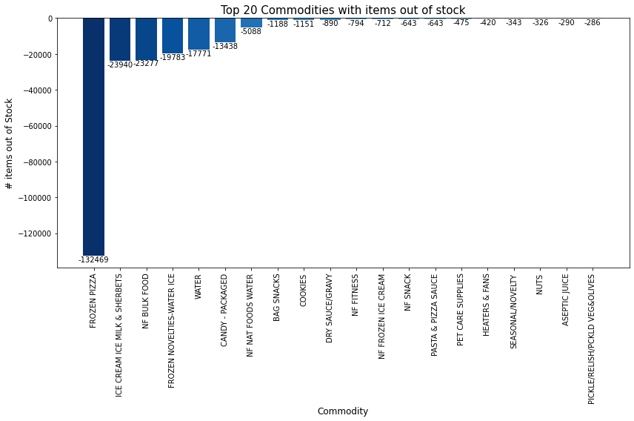
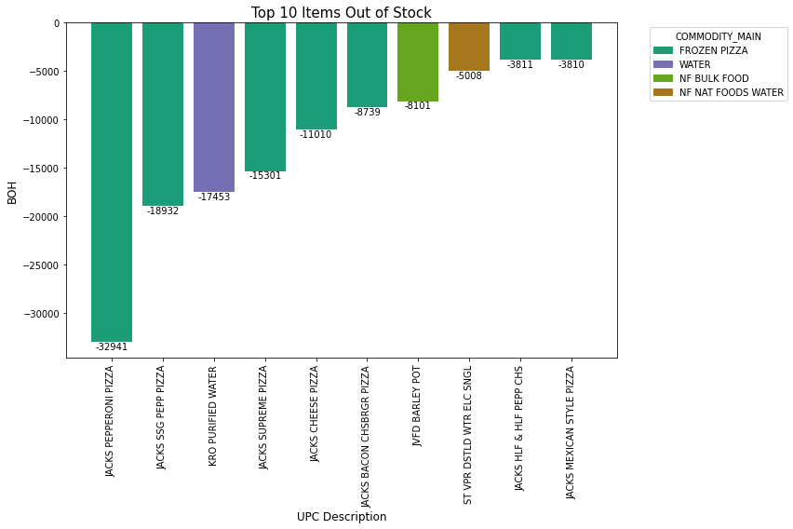
Understocked Items
Key Takeaway: Frozen Pizza is in huge demand and also being out of stock by a big margin of around 132K, out of which ~33K items were Jacks Pepperoni Pizza.

Slide 8
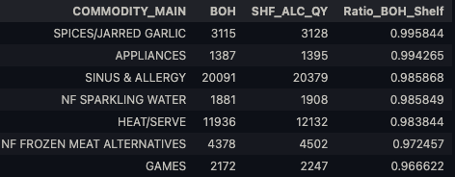

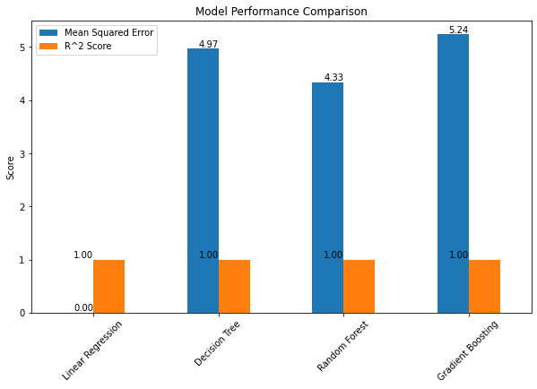

Drilled Insights
Commodities Indicating high demand and frequent sales
Commodities with best Inventory usage (more than 98%) occupancy
Linear regression model showcased greater accuracy with less error in predicting difference of BOH and SHF_ALC_QY
UPC Description Items Indicating high demand and frequent sales

Slide 9
KEY DECISIONS
Prioritize High-Demand Items
Market Analysis and Adjustments
Prioritize restocking understocked items like frozen pizza over overstocked items such as packaged and check lane candies.
Allocate more funds for Jacks Pepperoni Pizza instead of Reese’s and Starburst packaged candies.
Recognize commodities/products with high shelf allocation (>98 percentile, >60) and low BOH (<3 percentile, <1), such as Wet Cat Food, Frozen Kosher, Traditional Mexican Foods and items like Kroger Milk, Kroger Cling Wrap, Poor au Jus Gravy Mix.
Investigate marketing efforts for packaged candies during weeks 36 and 37 that may have driven sales in weeks 38 and 39.
Keep an eye on the Activity commodity as the BOH/SHF_ALC ratio has decreased, indicating rising demand and sales from week 30 to 39
Monitor Improving Commodities
Observe Produce Care and Handling due to its improvement in sales and effective inventory utilization (Refer to Heatmap)

Slide 10
KEY DECISIONS
Optimize Inventory Levels
Miscellaneous Findings
Reduce Overstocking: Cut back on restocking overstocked commodities like NF Baked Sweet Goods, which have been overstocked since week 37 despite good performance in weeks 35 and 36.
Adjust Declining Sales: Manage inventory for Hot Dogs, which saw increasing sales and perfect inventory utilization until week 36, but have had excess items in the backroom since week 37, indicating declining sales.
Examine the overstock of ENGZR Lithium AAA Batteries by 119 times despite good inventory utilization in their category.
Highlight commodities like Spices/Jarred Garlic, Appliances, Sinus and Allergy, Sparkling Water, and Heat/Serve that have >98% occupancy in inventory areas.
More Shelf Space
Allocate Shelf Space: Create space for commodities lacking shelf allocation such as J-Hook Items, Water Conditioning Salt, Glassware/Flatware, and Dinnerware.

Slide 11

Thank You !!!
For questions, please reach out to:
Sarthak Arora
Sart.1406.a@gmail.com
Portfolio

